Slide 1
Chapter 14:
Government Revenue and Spending
Section 1:
How Taxes Work pgs.410-419

Slide 2

Government Revenue – Key concepts
Governments provide certain public goods that generally are not provided by the market, like highways, education, law enforcement, and the court system.
The most important source of money to pay for these things is taxes.
A tax is a mandatory payment to a local, state, or national government.
Revenue is government income from taxes and nontax sources.
Nontax sources include borrowing and lotteries.
The rights of government to tax are set down in the U.S. Constitution and state constitutions.

Slide 3
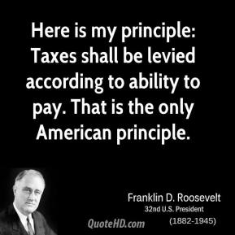
Principles of Taxation
The Benefits-Received Principle holds that people who benefit directly from public goods should pay for them in proportion to the amount of benefits received.
The Ability-to-Pay Principle holds that people should be taxed on their ability to pay, no matter the level of benefits they receive.

Slide 4
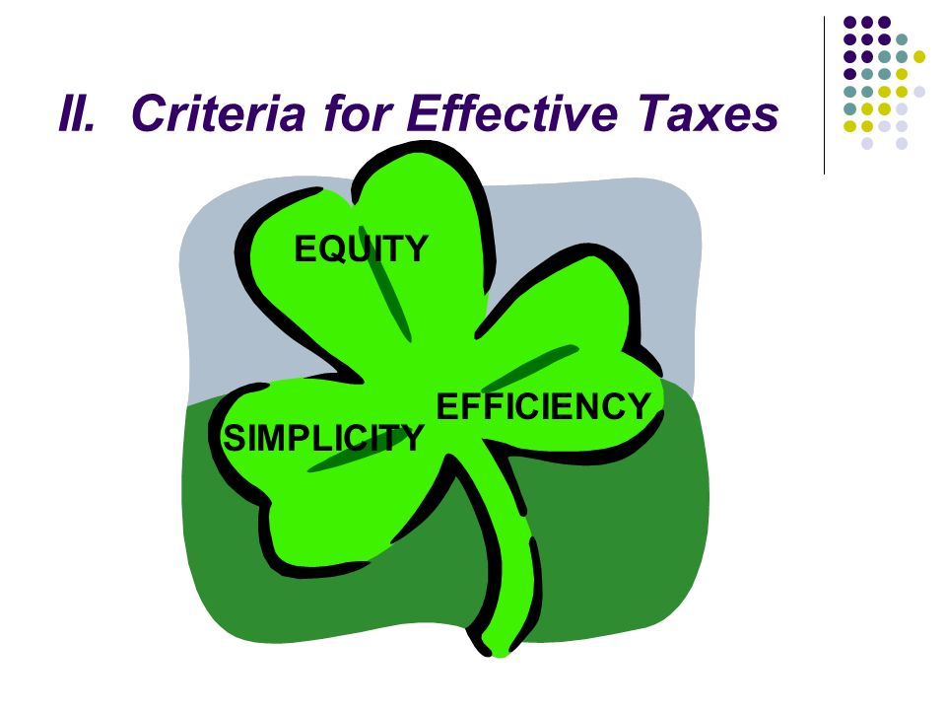
Criteria for Taxation
Equity, or fairness, of a tax is established by how uniformly the tax is applied. This requires that people in similar situations pay a similar amount of taxes.
Simplicity, is determined by how easy it is for the taxpayer to understand and how easy it is for the government to collect.
Efficiency of a tax can be judged by how well the tax achieves the goal of raising revenue for the government with the least cost in terms of administration.
However these three criteria are sometimes in conflict, and a given tax may not meet all of the criteria.

Slide 5
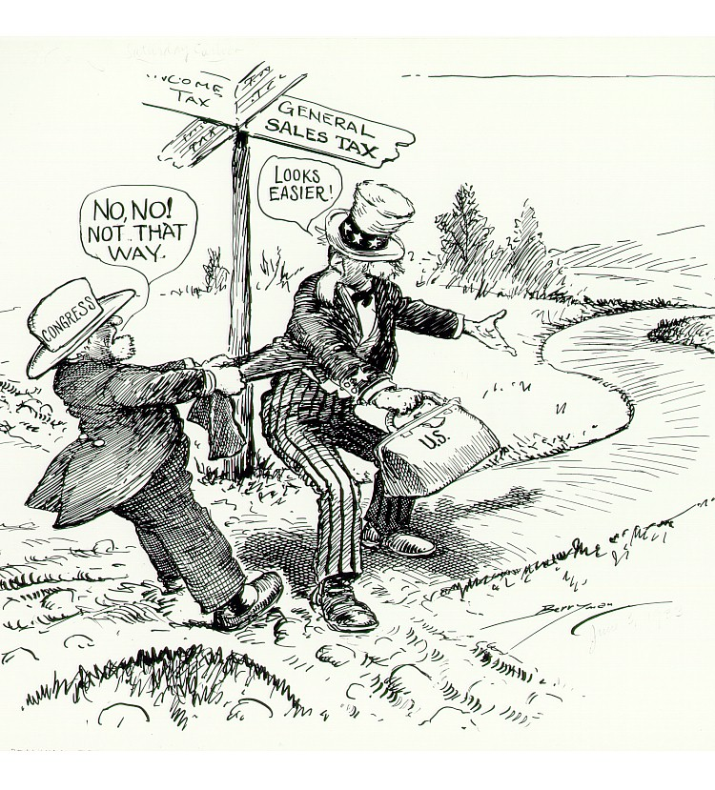
Tax Base – Key Concepts
Government imposes taxes on various forms of income and wealth in order to raise the revenue to provide public goods and various other services.
Each type of wealth subject to taxes is called a tax base.
There are four common tax bases.

Slide 6
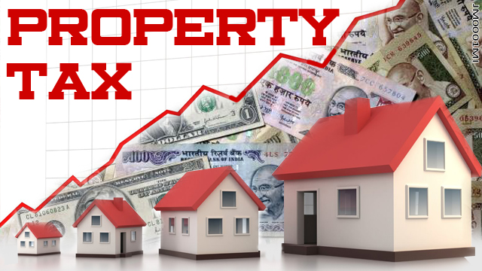
The Four Tax Bases
Individual income tax is a tax based on an individual’s income from all sources: wages, interest, dividends, and tips.
Corporate income tax is a tax on a corporation’s profits.
Sales tax is a tax on the value of designated goods or services. It is usually a percentage of the posted price of the good and is included in the final price.
Property tax is a tax based on the value of an individual’s or business’s assets, generally real estate.

Slide 7
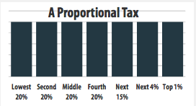
Tax Structures – Proportional Tax
A proportional tax takes the same percentage of income from all taxpayers, regardless of income level.
A proportional tax is sometimes called a flat tax, because the rate of tax is the same for all taxpayers.

Slide 8
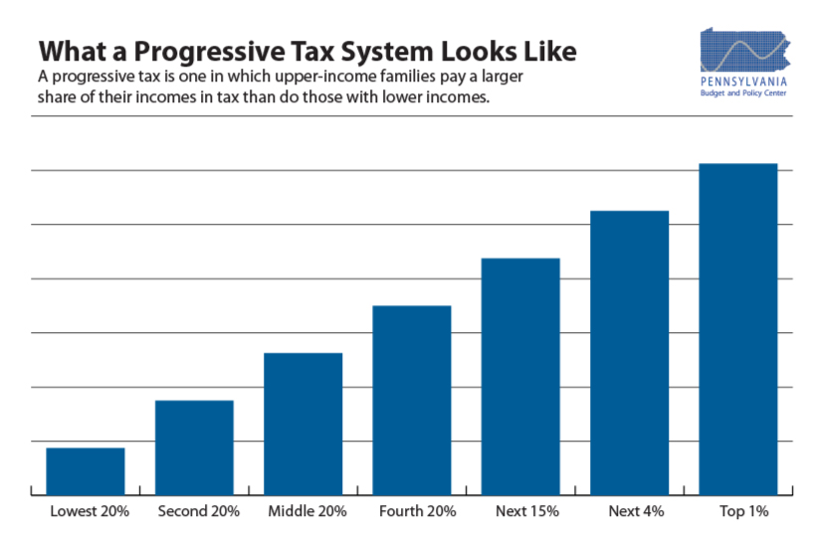
Tax Structures – Progressive tax
A progressive tax is based on income level.
It takes a larger percentage of income from high-income earners and a smaller percentage of income from low-income earners.
Under this system a high-income person not only pays more in the amount of taxes but also pays higher percentage of income in taxes. (see figure 14.1 on pg.413)
In the U.S., the federal income tax is a progressive tax, as well as most state income taxes. (we will learn more about this is Chapter 14 section 2)

Slide 9
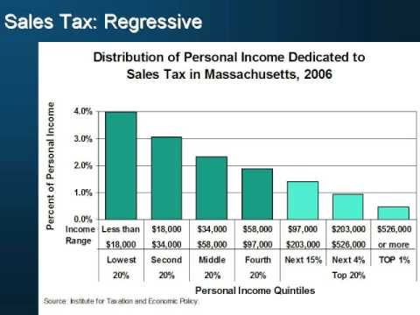
Tax Structures – Regressive Tax
A regressive tax hits low-income earners harder than it hits high-income earners.
This is because the proportion of income that goes to taxes falls as income rises.
Sales-tax and property taxes are considered regressive because low-income people send more on taxable goods and housing than high-income folks. (see pg.414)

Slide 10
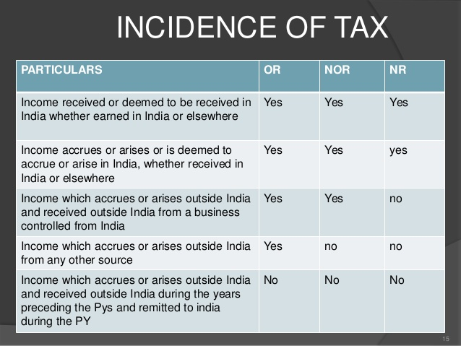
Who Pays the Tax?
The incidence of a tax is the final burden of that tax. In other words, it is the impact of the tax on a taxpayer.
For example, taxes imposed on businesses may get passed on to the consumer in the form of higher prices.

Slide 11
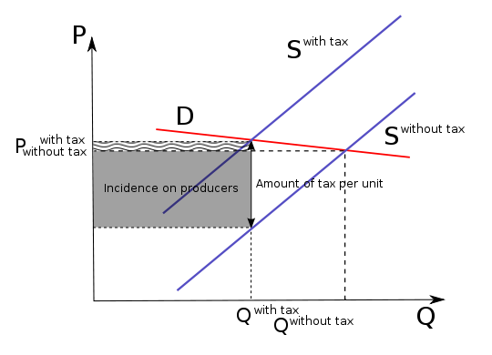
Effect of Elasticity on Taxes
If a product has elastic demand, the seller pays more of the tax, b/c the seller faces decreased quantity demanded if the prices rise.
If the product has inelastic demand, the consumer pays more of the tax in the form of higher prices.

Slide 12
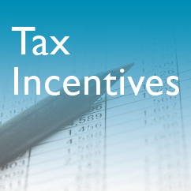
Impact of Taxes on the Economy
Impact 1 - Resource Allocation, a tax placed on a good or service will increase the costs of production and therefore shift the supply curve to the left.
Impact 2 – Productivity & Growth, when taxes on interest and dividends are high, people tend to save less than when taxes on this source of income are low. T/f, taxes also have an impact on the amount of money available to producers to invest in their businesses.
Impact 3 – Economic Behavior, A tax incentive is the use of taxes to encourage or discourage certain economic behaviors.

